Slide 1
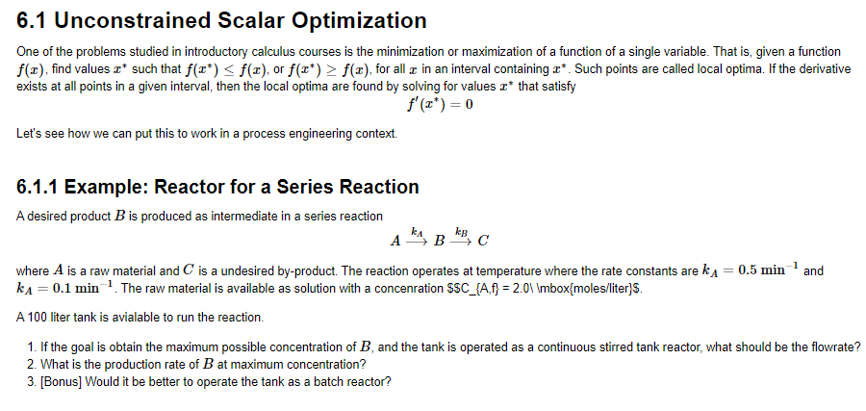
Optimization: Unconstrained Scalar Optimization

Slide 2
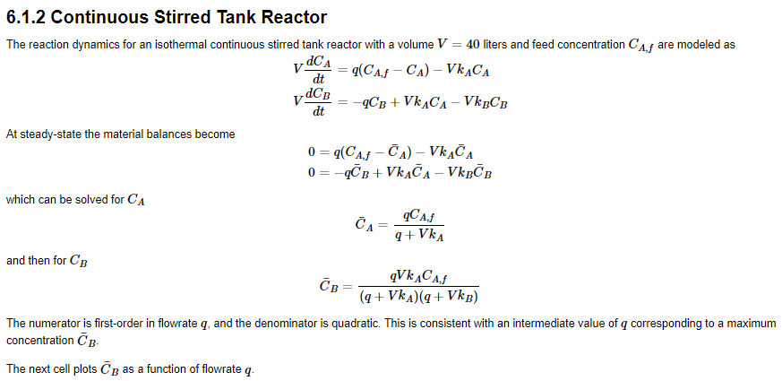
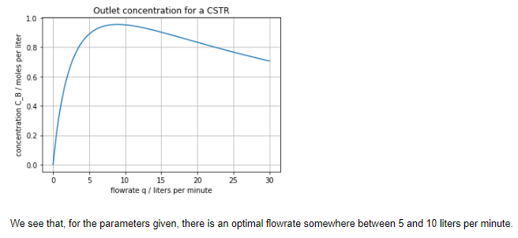
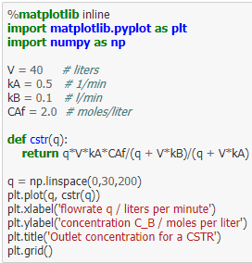
Optimization: Unconstrained Scalar Optimization

Slide 3
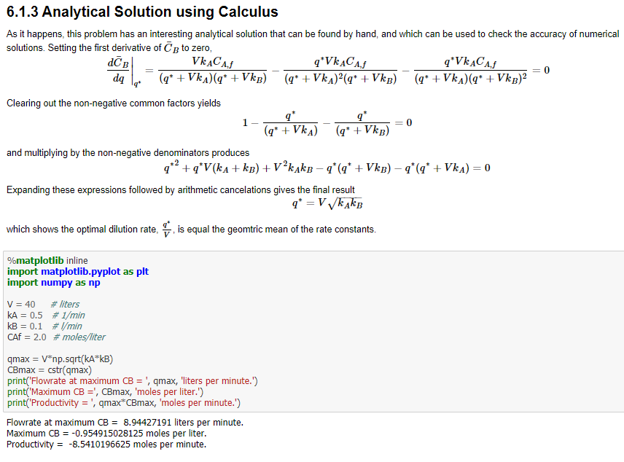
Optimization: Unconstrained Scalar Optimization

Slide 4
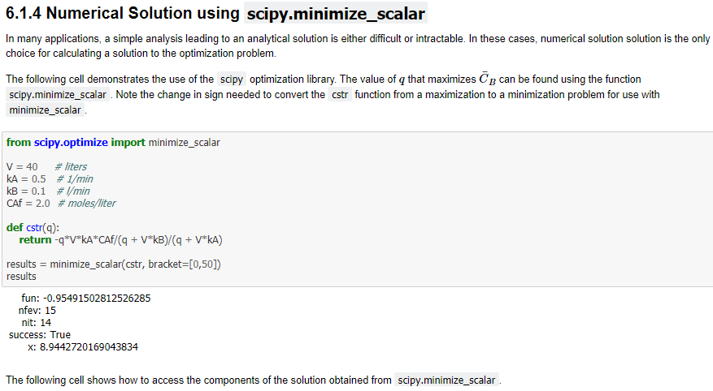
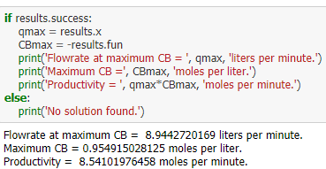
Optimization: Unconstrained Scalar Optimization

Slide 5
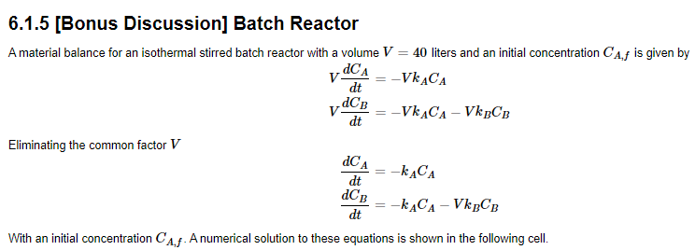
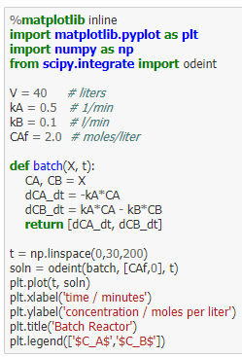
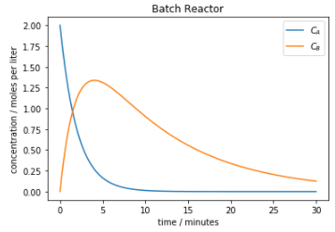
Optimization: Unconstrained Scalar Optimization

Slide 6
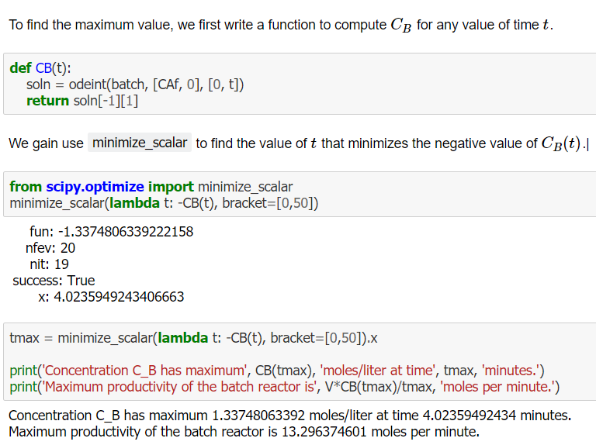
Optimization: Unconstrained Scalar Optimization

Slide 7
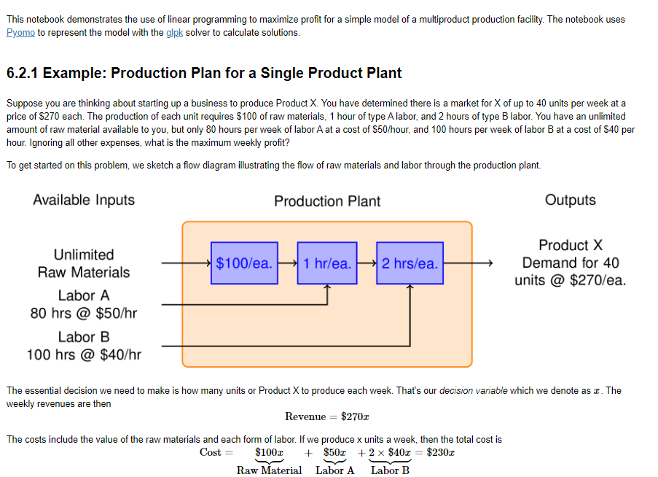
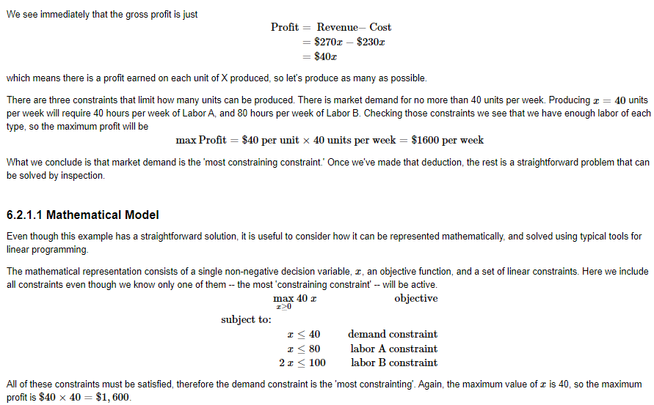
Optimization: Linear Production Model

Slide 8
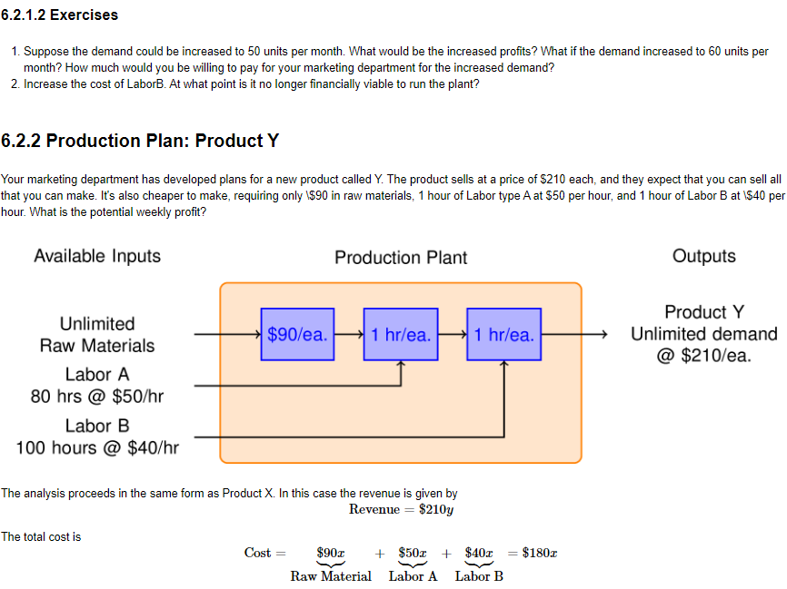
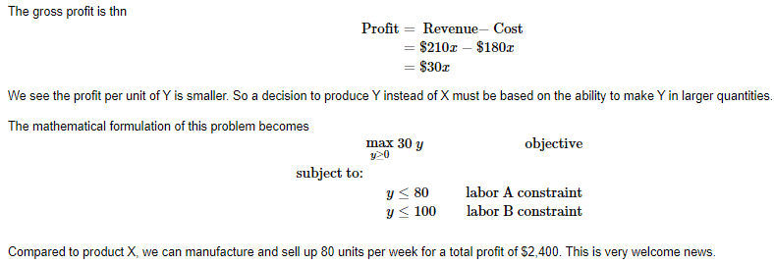
Optimization: Linear Production Model

Slide 9
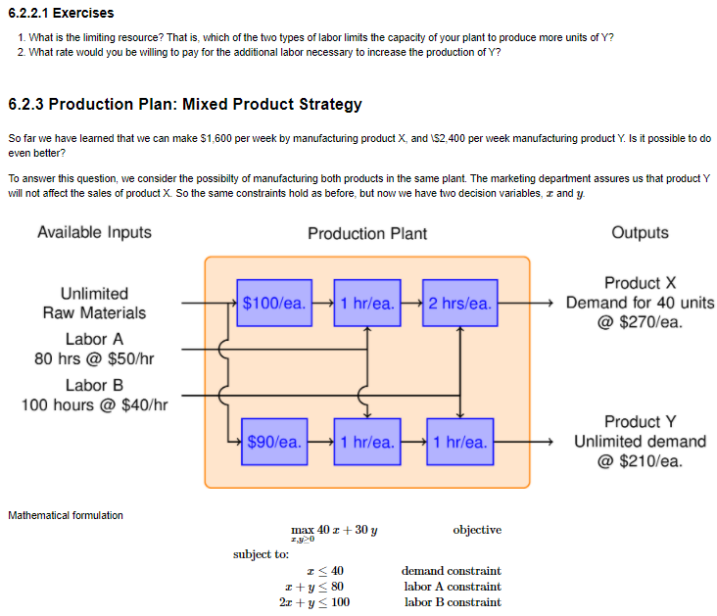
Optimization: Linear Production Model

Slide 10
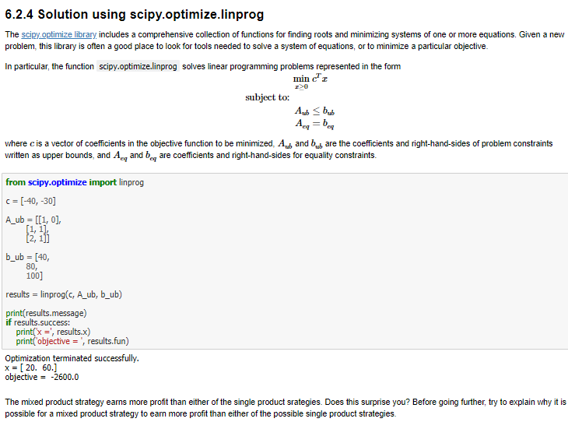
Optimization: Linear Production Model

Slide 11
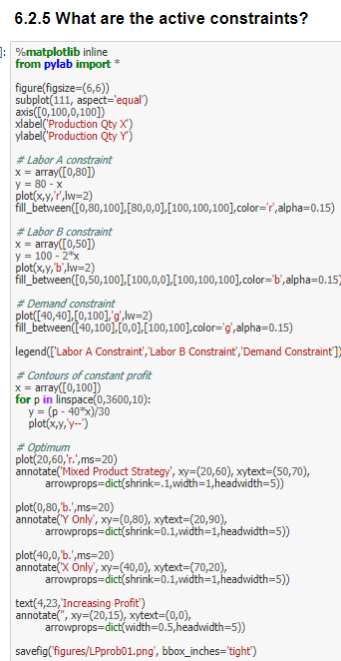
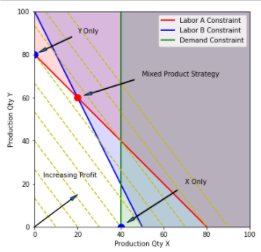
Optimization: Linear Production Model

Slide 12
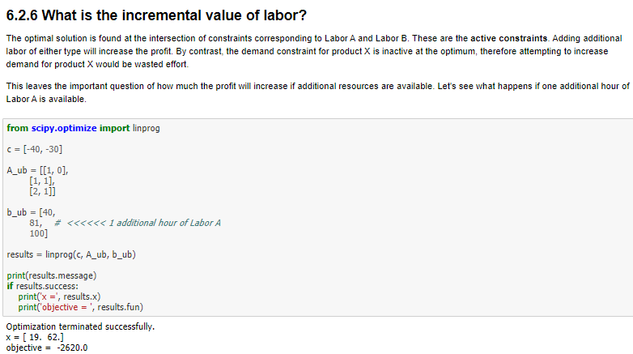
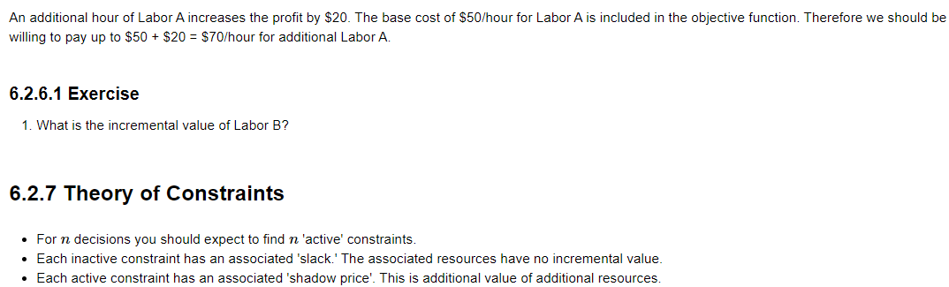
Optimization: Linear Production Model

Slide 13
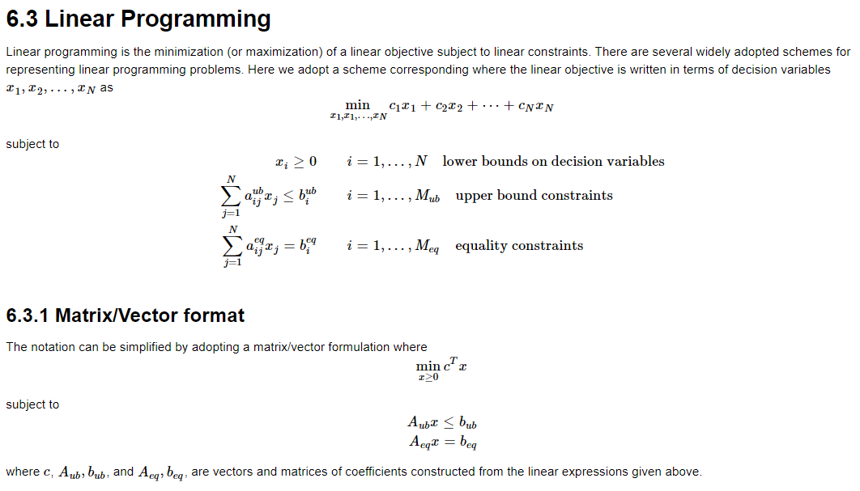
Optimization: Linear Programming

Slide 14
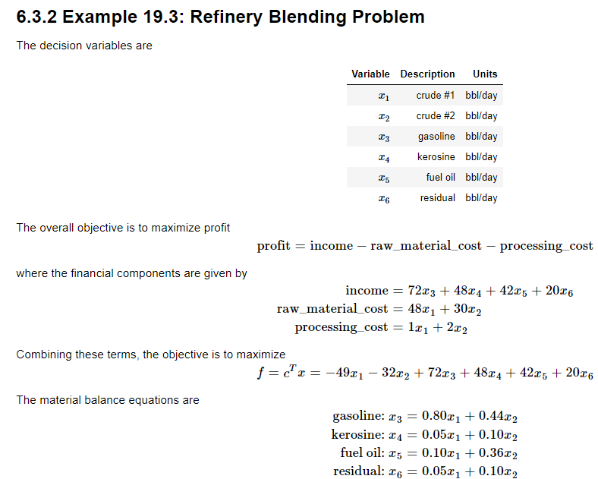
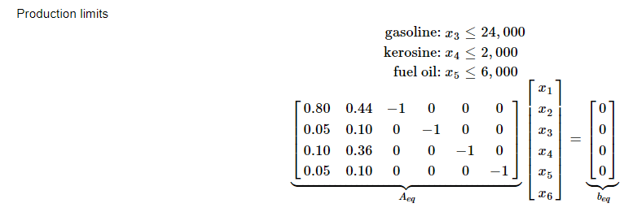
Optimization: Linear Programming

Slide 15
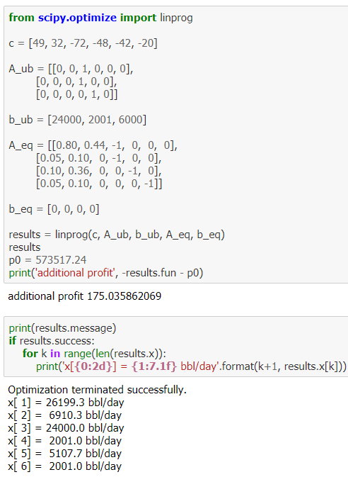
Optimization: Linear Programming

Slide 16
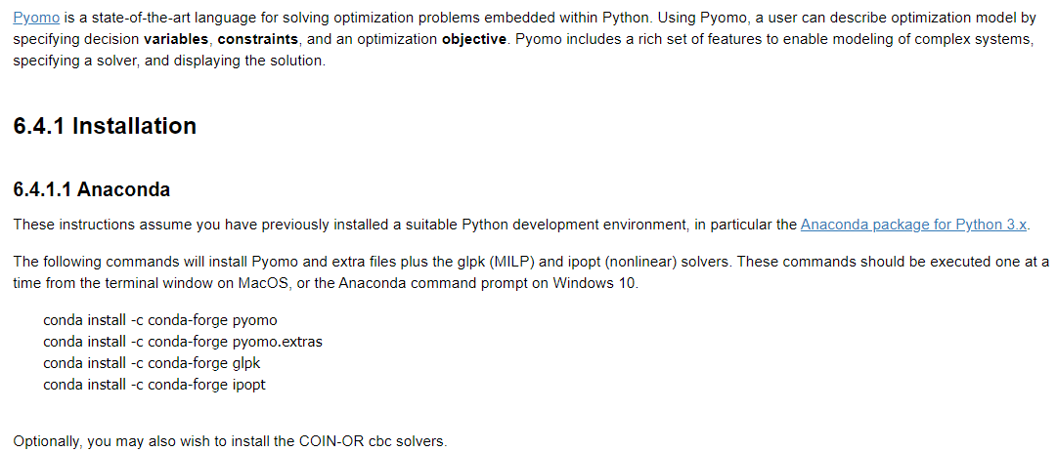
Optimization: Linear Production Model in Pyomo

Slide 17
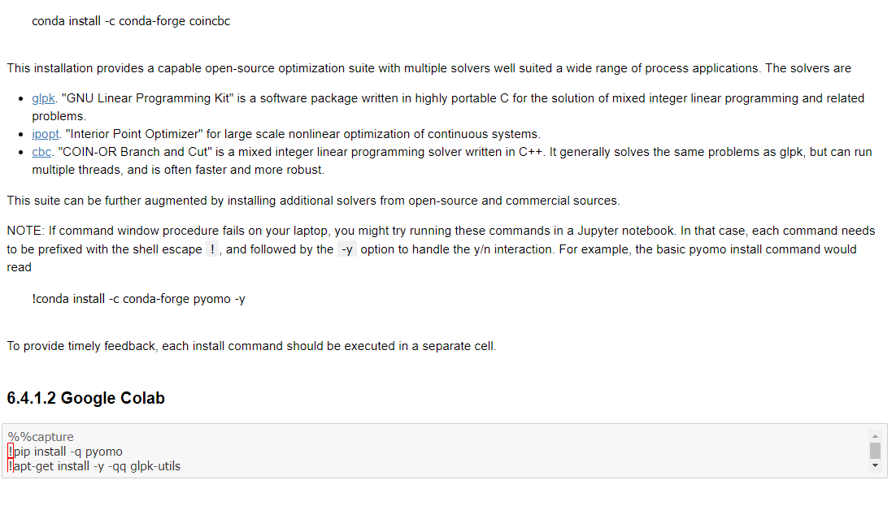
Optimization: Linear Production Model in Pyomo

Slide 18
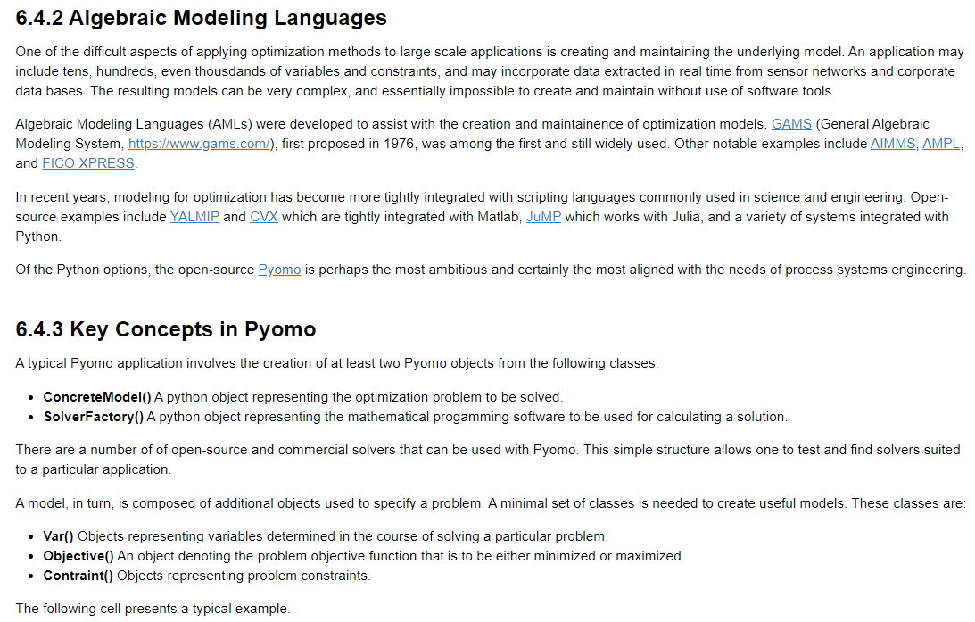
Optimization: Linear Production Model in Pyomo

Slide 19
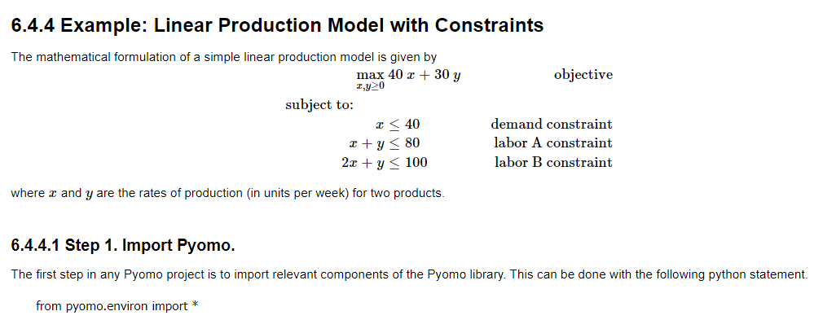
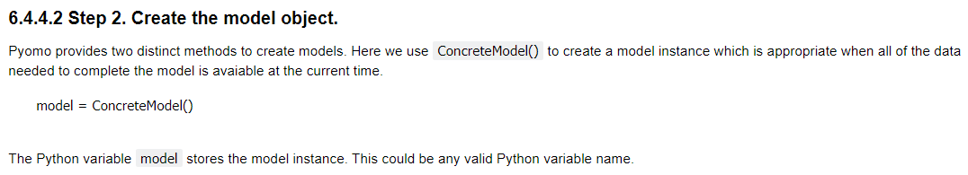
Optimization: Linear Production Model in Pyomo

Slide 20
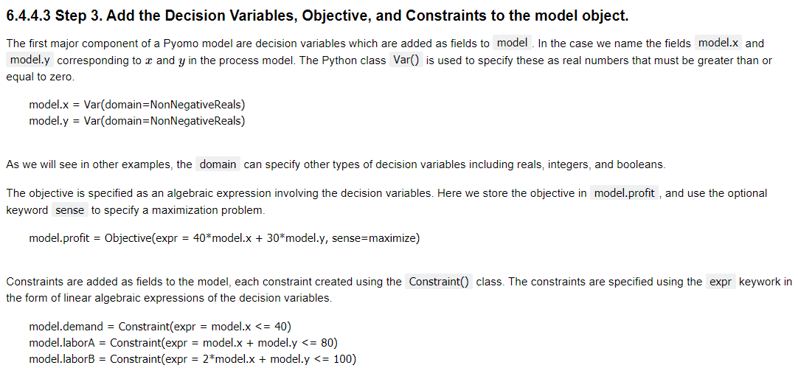
Optimization: Linear Production Model in Pyomo

Slide 21
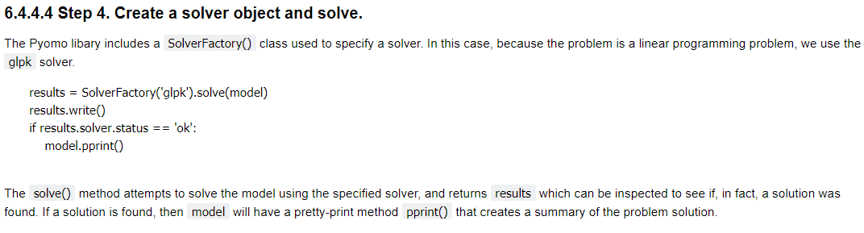
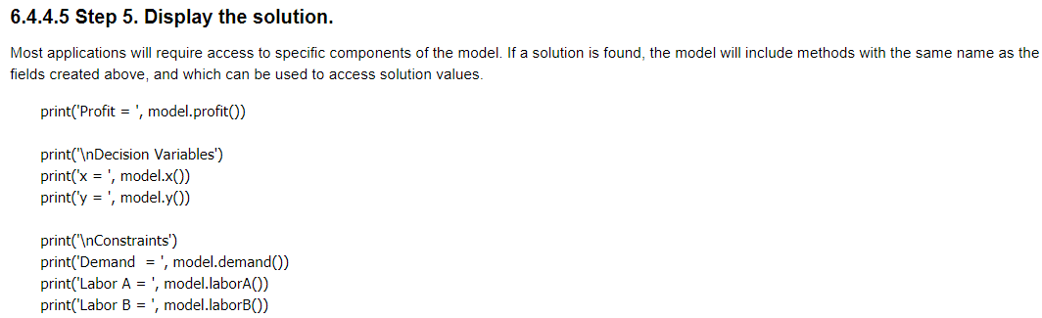
Optimization: Linear Production Model in Pyomo

Slide 22
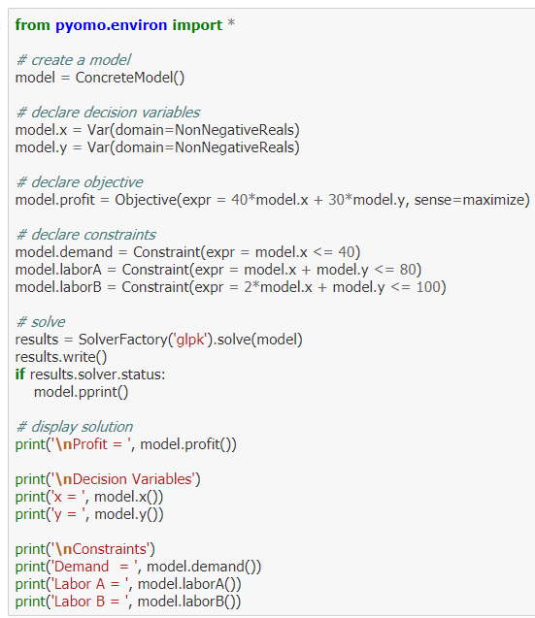
Optimization: Linear Production Model in Pyomo

Slide 23
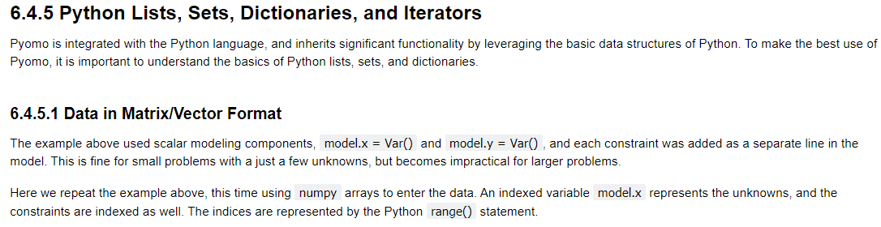
Optimization: Linear Production Model in Pyomo

Slide 24
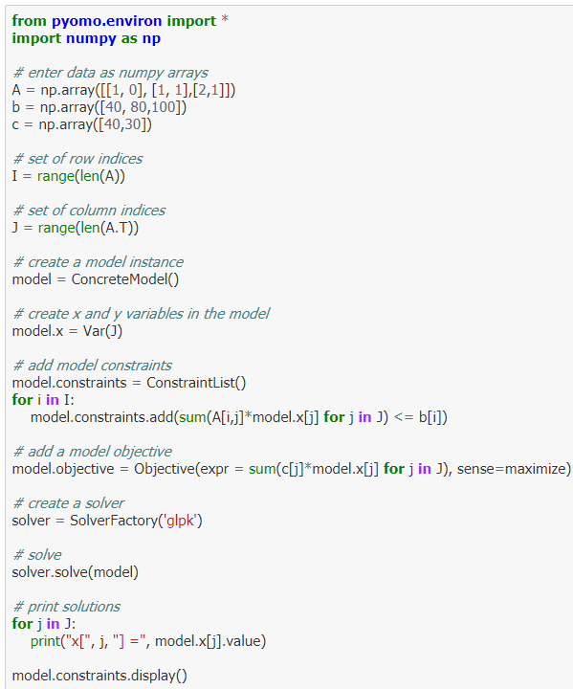
Optimization: Linear Production Model in Pyomo

Slide 25
Optimization: Linear Production Model in Pyomo

Slide 26
Optimization: Linear Production Model in Pyomo

Slide 27
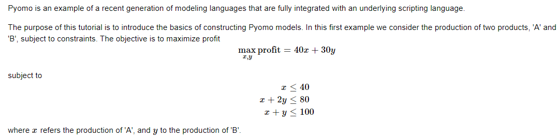
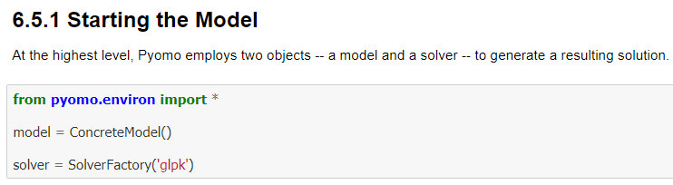
Optimization : Linear Programming in Pyomo

Slide 28
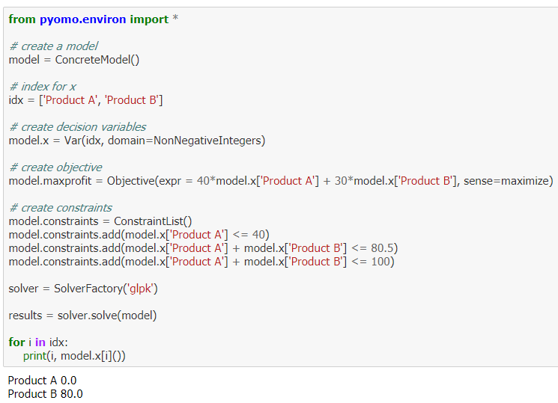
Optimization : Linear Programming in Pyomo

Slide 29
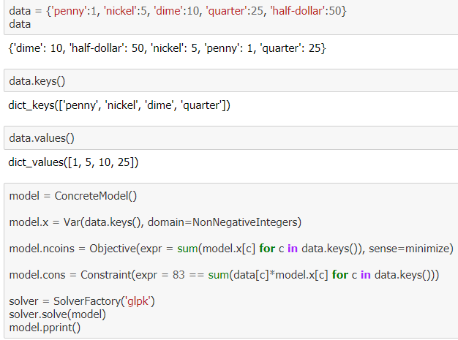
Optimization : Linear Programming in Pyomo

Slide 30
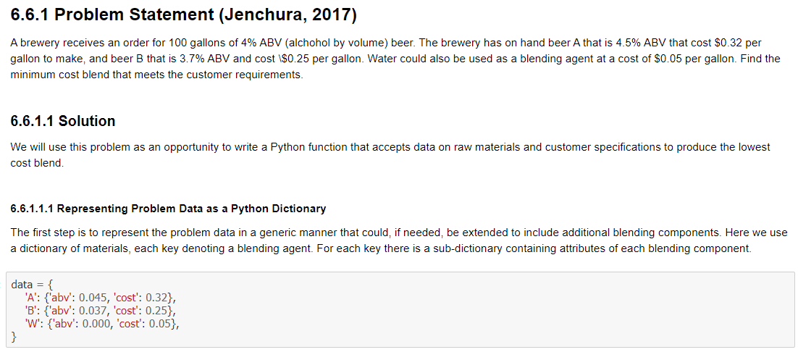
Optimization : Linear Blending Problem

Slide 31
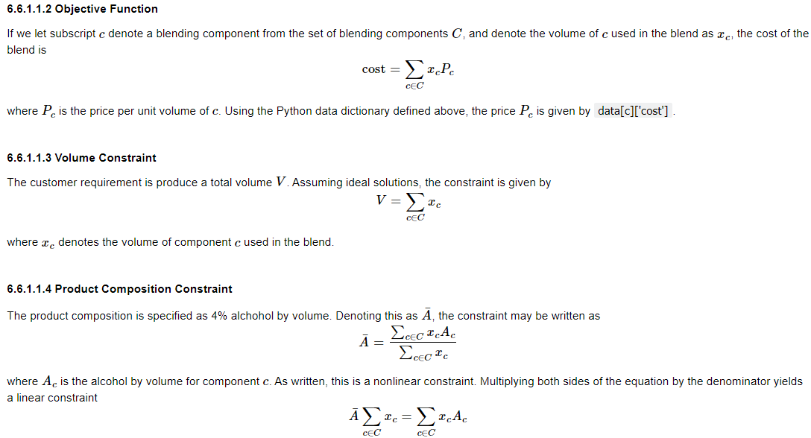
Optimization : Linear Blending Problem

Slide 32
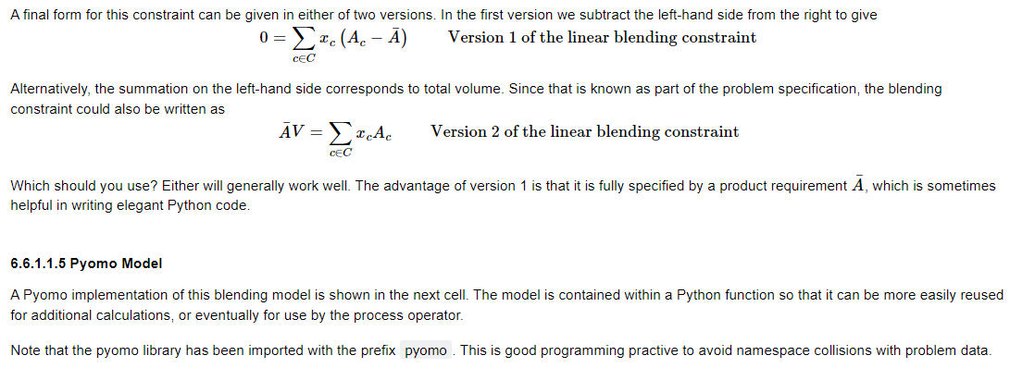
Optimization : Linear Blending Problem

Slide 33
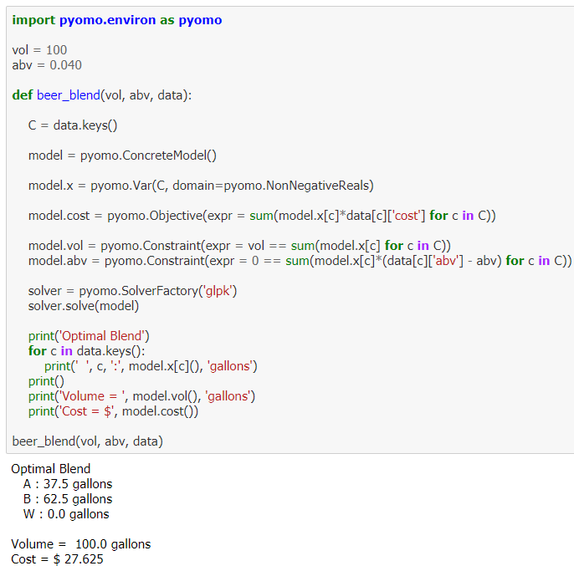
Optimization : Linear Blending Problem

Slide 34
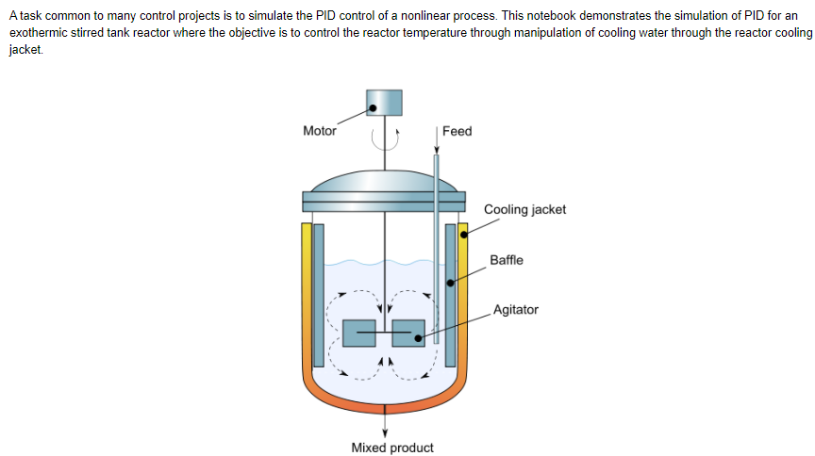
Process Modeling : Implementing PID Control in Nonlinear Simulations

Slide 35
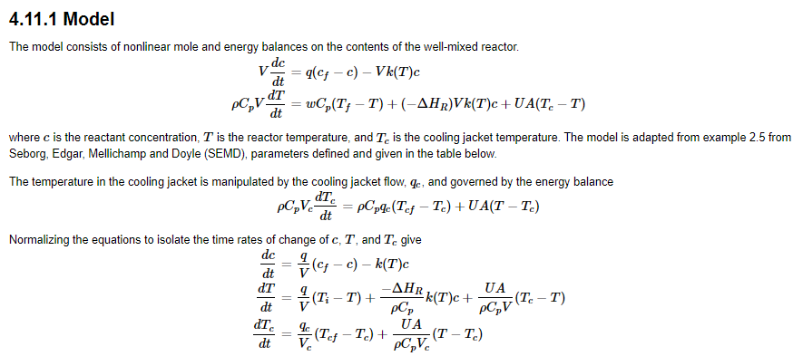
Process Modeling : Implementing PID Control in Nonlinear Simulations

Slide 36
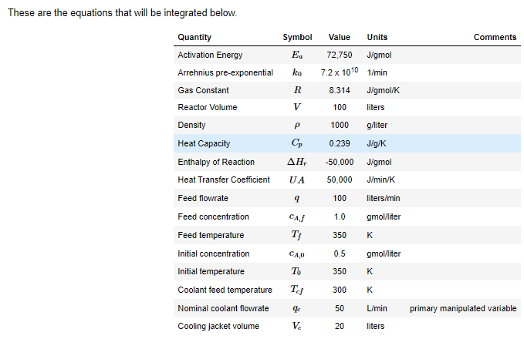
Process Modeling : Implementing PID Control in Nonlinear Simulations

Slide 37
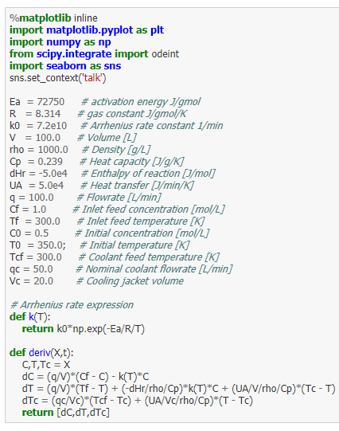
Process Modeling : Implementing PID Control in Nonlinear Simulations

Slide 38
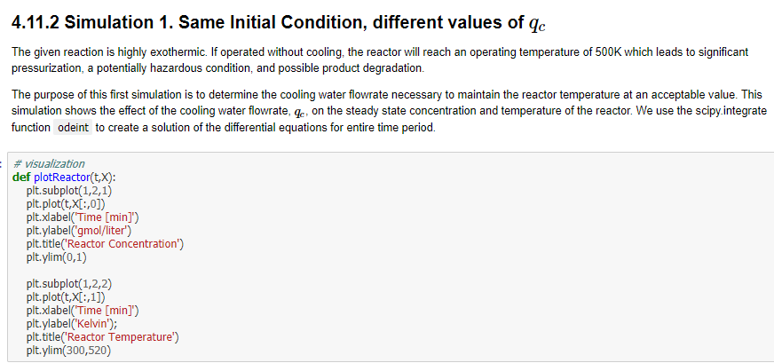
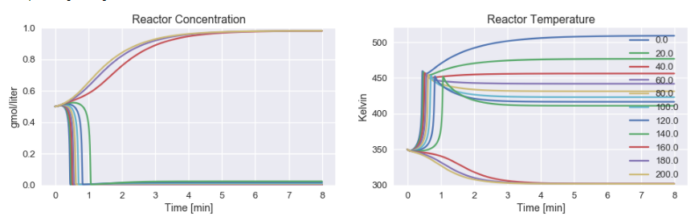

Process Modeling : Implementing PID Control in Nonlinear Simulations

Slide 39


Process Modeling : Implementing PID Control in Nonlinear Simulations

Slide 40


Process Modeling : Implementing PID Control in Nonlinear Simulations

Slide 41


Process Modeling : Implementing PID Control in Nonlinear Simulations

Slide 42


Process Modeling : Implementing PID Control in Nonlinear Simulations

Slide 43

Process Modeling : Implementing PID Control in Nonlinear Simulations

Slide 44

Process Modeling : Implementing PID Control in Nonlinear Simulations

Slide 45



Process Modeling : Implementing PID Control in Nonlinear Simulations

Slide 46



Process Modeling : Implementing PID Control in Nonlinear Simulations

Slide 47


Process Modeling : Implementing PID Control in Nonlinear Simulations

Slide 48

Process Modeling : Implementing PID Control in Nonlinear Simulations

Slide 49

Process Modeling : Implementing PID Control in Nonlinear Simulations

Slide 50

Process Modeling : Implementing PID Control in Nonlinear Simulations

Slide 51

Process Modeling : Implementing PID Control in Nonlinear Simulations

Slide 52

Process Modeling : Interactive PID Control Tuning with Ziegler-Nichols

Slide 53

Process Modeling : Interactive PID Control Tuning with Ziegler-Nichols

Slide 54

Process Modeling : Interactive PID Control Tuning with Ziegler-Nichols

Slide 55

Process Modeling : Interactive PID Control Tuning with Ziegler-Nichols

Slide 56

Process Modeling : Interactive PID Control Tuning with Ziegler-Nichols

Slide 57


Process Modeling : Interactive PID Control Tuning with Ziegler-Nichols

Slide 58

Process Modeling : Interactive PID Control Tuning with Ziegler-Nichols

Slide 59

Optimization : Linear Blending Problem

Slide 60

Optimization : Linear Blending Problem

Slide 61


Optimization : Linear Blending Problem

Slide 62

Optimization : Linear Blending Problem

Slide 63

Optimization : Linear Blending Problem

Slide 64


Optimization : Linear Blending Problem

Slide 65

Optimization : Linear Blending Problem

Slide 66

Optimization : Gasoline Blending

Slide 67


Optimization : Gasoline Blending

Slide 68

Optimization : Gasoline Blending

Slide 69

Optimization : Gasoline Blending

Slide 70


Optimization : Gasoline Blending

Slide 71


Optimization : Gasoline Blending

Slide 72

Optimization : Gasoline Blending

Slide 73


Optimization : Gasoline Blending

Slide 74

Optimization : Pyomo Examples

Slide 75

Optimization : Pyomo Examples

Slide 76

Optimization : Pyomo Examples

Slide 77

Optimization : Pyomo Examples

Slide 78


Optimization : Pyomo Examples

Slide 79



Optimization : Pyomo Examples

